Slide 1

Gold
Prediction
By Nirmal Koshy

Slide 2

Problem Overview
The problem overview for this project involves leveraging a comprehensive dataset of daily gold prices obtained from Nasdaq, spanning from January 19, 2014, to January 22, 2024. The dataset includes key financial metrics such as opening and closing prices, trading volume, as well as the highest and lowest prices recorded each day. The goal likely involves analyzing trends, patterns, and relationships within the data to inform investment decisions, forecast future prices, or gain insights into market behavior.

Slide 3


Objective
The objective of leveraging the comprehensive dataset of daily gold prices obtained from Nasdaq, covering the period from January 19, 2014, to January 22, 2024, is to conduct a detailed analysis aimed at informing investment decisions and strategies in the gold market. This analysis involves several key objectives, including price analysis and forecasting through statistical and machine learning techniques, risk assessment and management by analyzing historical volatility and correlations with other assets, gaining insights into market behavior and drivers of gold prices such as geopolitical events and economic indicators, developing trading strategies to optimize buying and selling decisions, incorporating gold into investment portfolios for diversification and enhanced returns, and providing decision support for investors and policymakers based on historical price data and its implications for financial markets and the economy. Overall, the aim is to utilize the dataset to gain actionable insights and facilitate informed decision-making processes related to gold trading and portfolio management.

Slide 4

Data Science
Problem
Predictive modeling for gold prices, risk assessment, portfolio optimization insights.
Business
Problem
Leveraging daily gold price data for predictive modeling, risk assessment, and portfolio optimization to inform investment decisions and strategies, enhancing performance and mitigating risks in the gold market.

Slide 5

EXPLORATORY DATA ANALYSIS

Slide 6
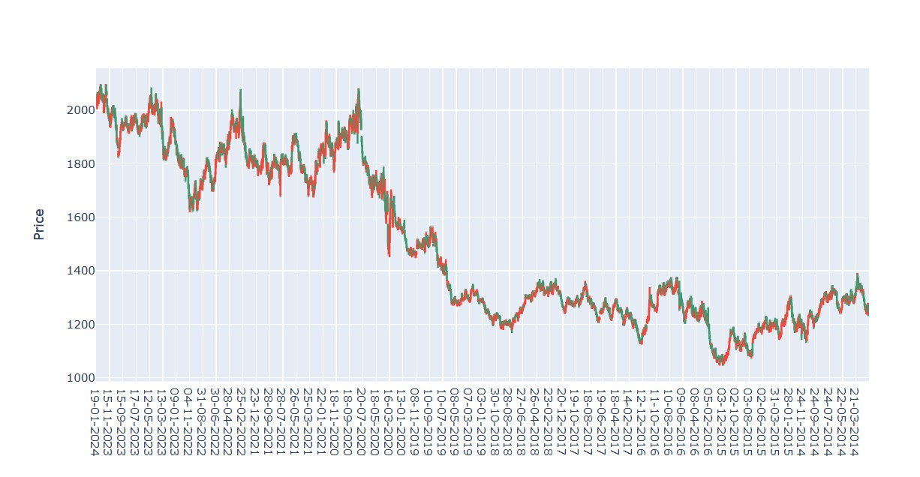
What is the variation of gold prices every year?

Slide 7
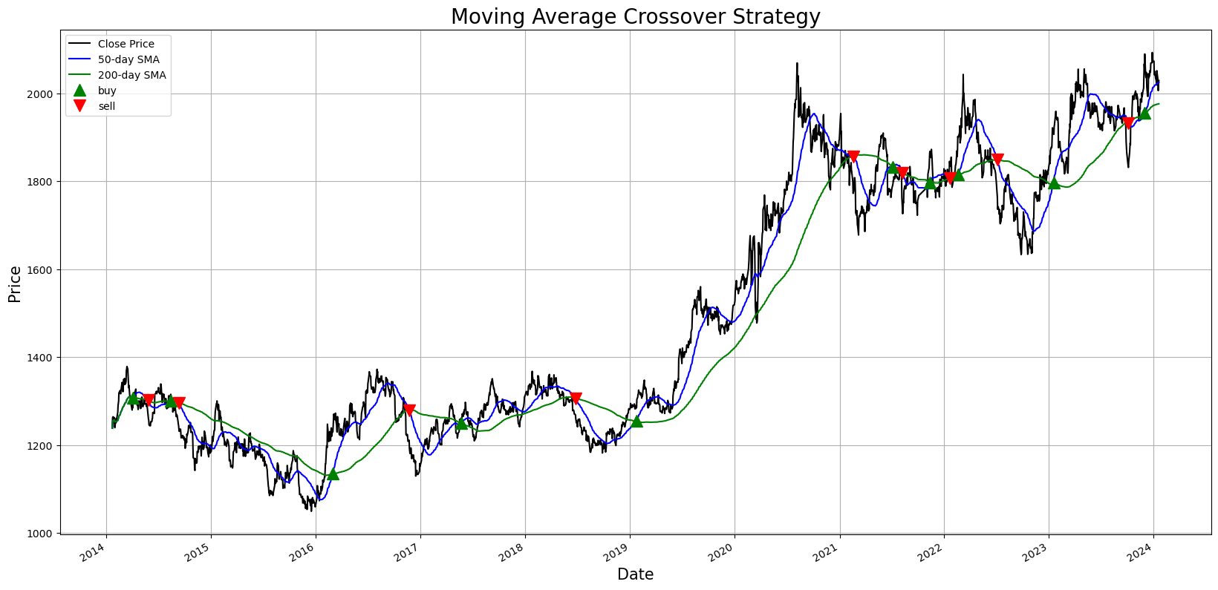
Observation
In the moving crossover strategy, we have used 50 for short term moving average and 200 for long term moving average.
A buy signal is indicated when the short term moving average crosses above long term moving average.
Contrary a sell signal is indicated when the short term moving average crosses below long term moving average.

Slide 8
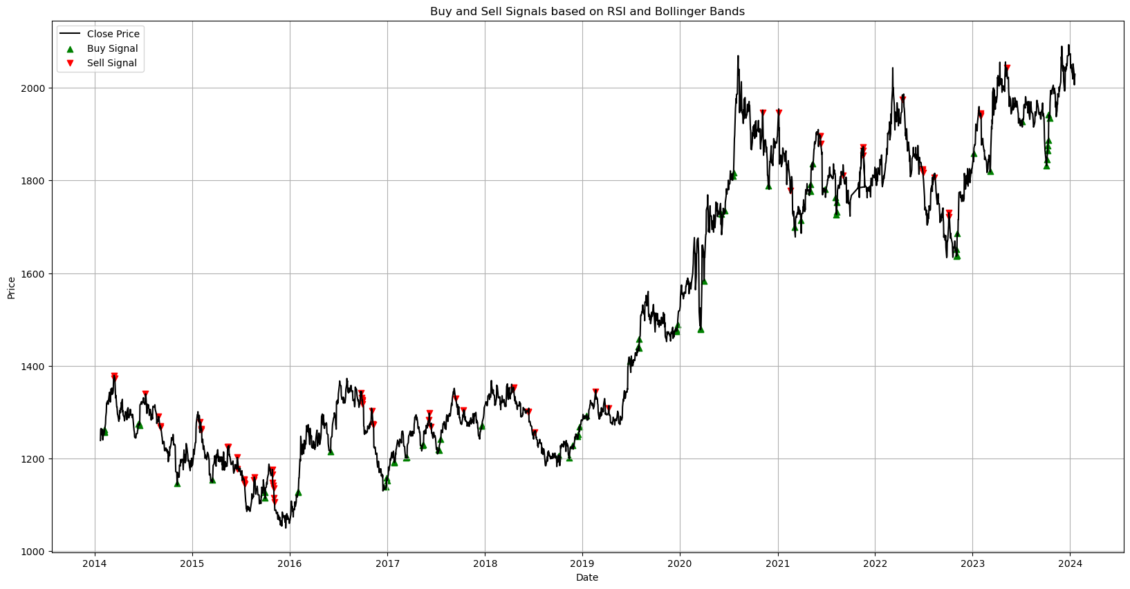
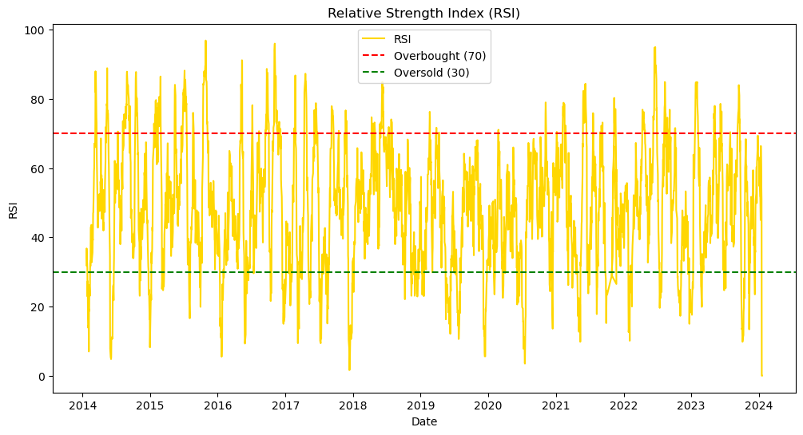

Slide 9
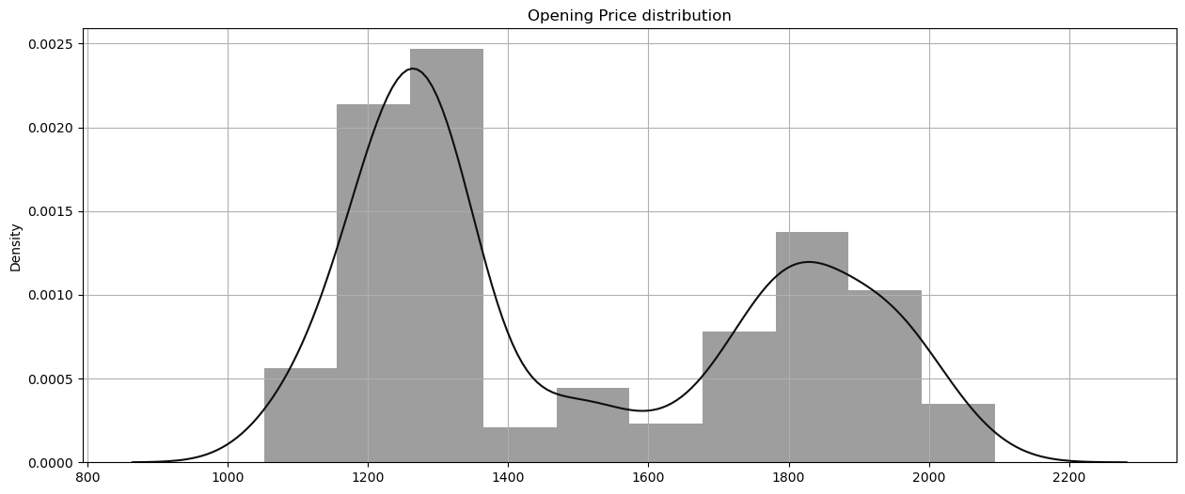
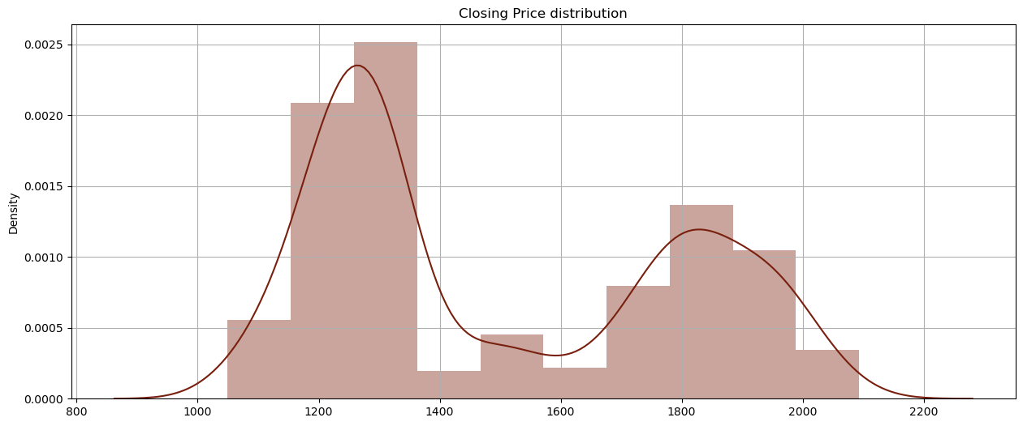
The opening price of the gold mostly lie in $1300 range since it has the highest density. $1400 and $1600 are very less scattered in the dataset.
Likewise for closing price, the closing price of the gold mostly lie in $1300 range since it has the highest density. $1400 and $1600 are very less scattered in the dataset.

Slide 10
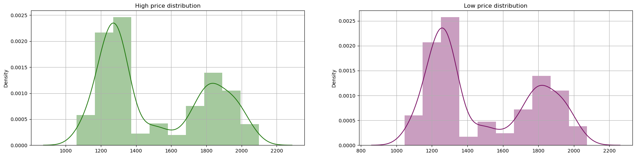
Comparative Analysis of High and Low Gold Prices
Highest and lowest recorded price of gold for majority of the days lie in the range of $1300 which has the highest density in the both the plots.

Slide 11
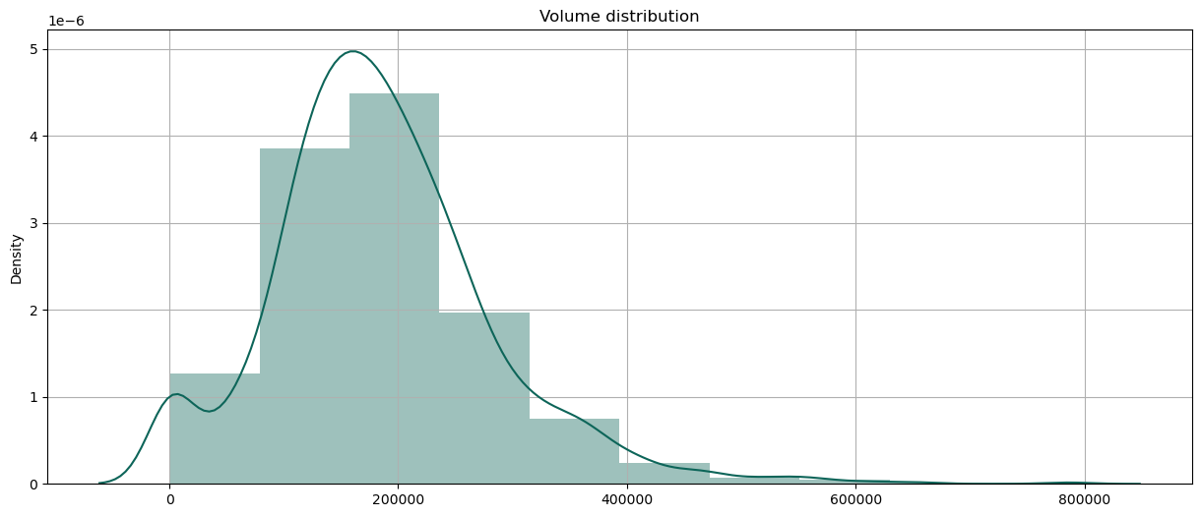
Volume represents the total number of shares traded for gold on each day. As seen in the graph, 200000 is the value of volume with highest frequency. Traders pay attention to this volume level as it could represent a point of interest or significance in the market.

Slide 12

MODEL
BUILDING
PHASE

Slide 13


Model Building Stages
Feature Engineering
Feature Selection
Model Selection
Evaluation Metrics

Slide 14

Strategy
Feature Engineering
50_SMA, 200_SMA, Signal, RSI, Upper Bollinger, Lower Bollinger
Feature Selection
Drop Open, High, Low, Volume for forecasting
Model Selection
Linear Regression, Random Forest, Prophet
Evaluation Metrics
Mean-squared error, Root mean-squared error

Slide 15

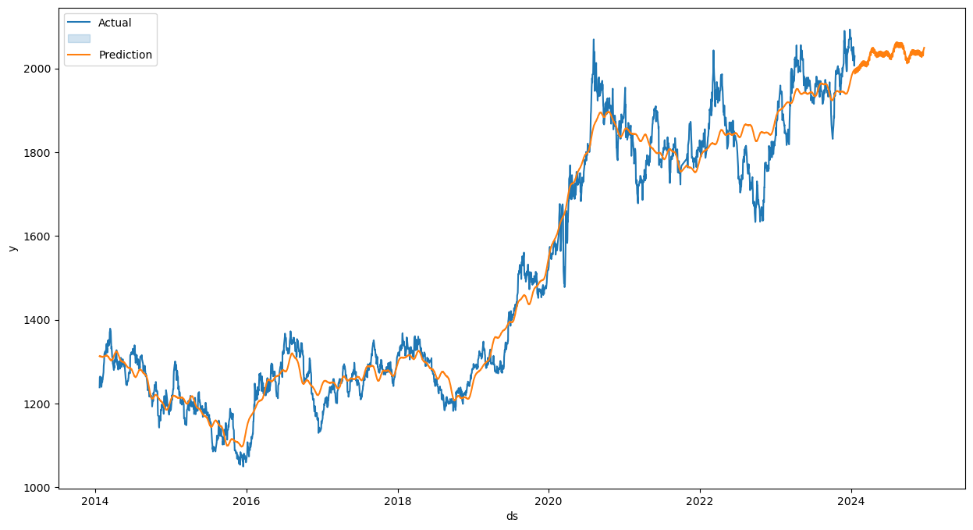
Mean-squared error
5.19
Root mean-squared error
2.27

Slide 16

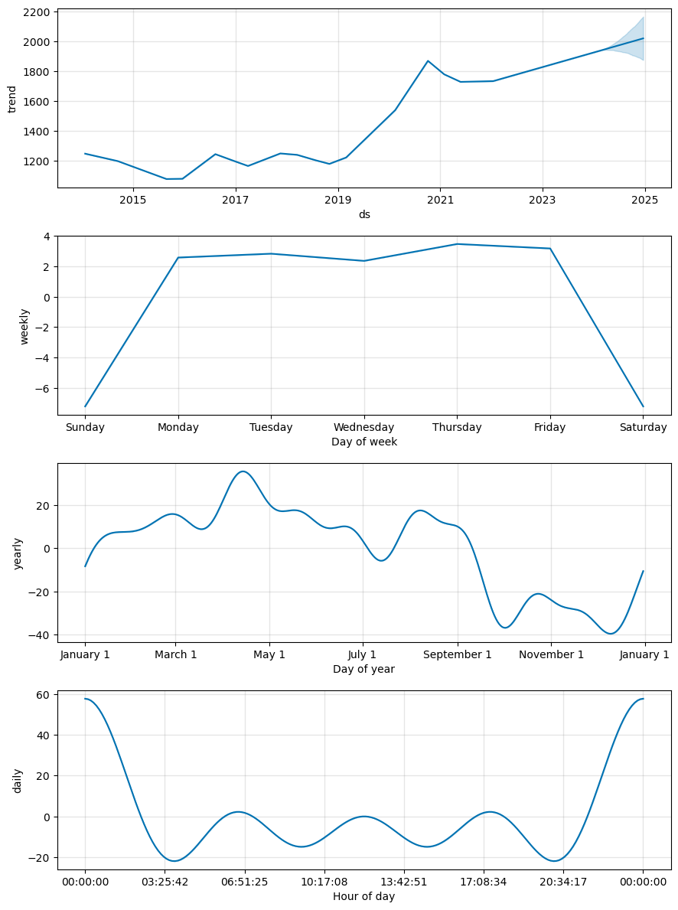
This is the plot indicating prediction for next 6 months. As seen in the graph in the year 2024 the price seems be in the range of 2000 and doesn’t exceed 2200.

Slide 17

LEARNINGS
As seen in the first graph, gold prices kept increasing every year. However, gold has been bolstered by increased risk and uncertainty in 2022, with global tensions being the most evident source. Another element that has contributed is high inflation, however not all investors have seen the inflation risk in the same way. This reason gold prices had seen significant decline in November 2022.
The buy signal in 2019 indicates that the shorter term average crossed above the longer term average, suggesting a potential uptrend in the price of the gold. There was positive momentum in the gold leading the investors to buying the gold anticipating further price increases.
When the RSI value is below 30 and close price falls below lower Bollinger, buy the gold as the price of the gold has fallen extremely low and that the gold is oversold otherwise it is overbought.

